Slide 1
Customer Loan Report
By Group 1

Slide 2
KPI
Year wise loan amount Stats
Grade and sub grade wise revolving balance
Total Payment for Verified Status Vs Total Payment for Non- Verified Status
State wise and month wise loan status
Home ownership Vs last payment date stats

Slide 3
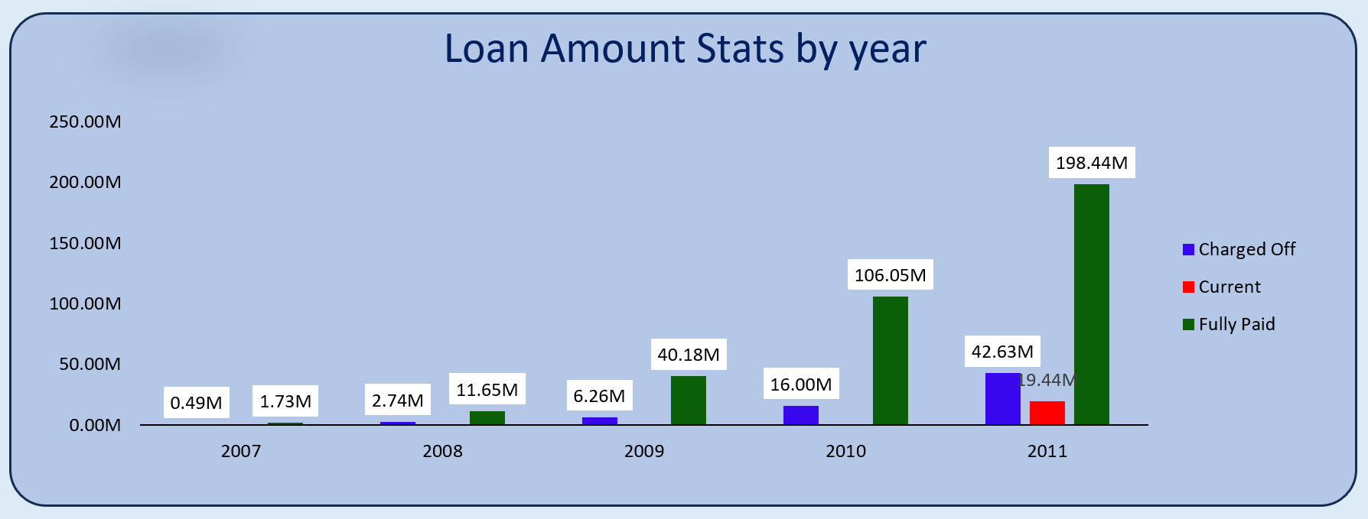
The sum of loan amounts exhibited an upward trend from 2007 to 2011, increasing by 258.28 million during this period.

Slide 4
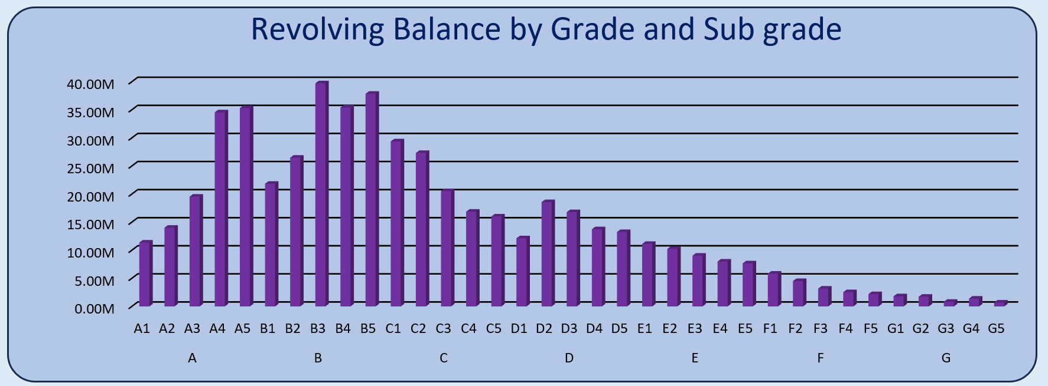
At 161.3 million, B claimed the top spot for the highest Sum of revolving balance, far outpacing G's Sum of revolving balance, which was a mere 6.46 million dollars in comparison.

Slide 5
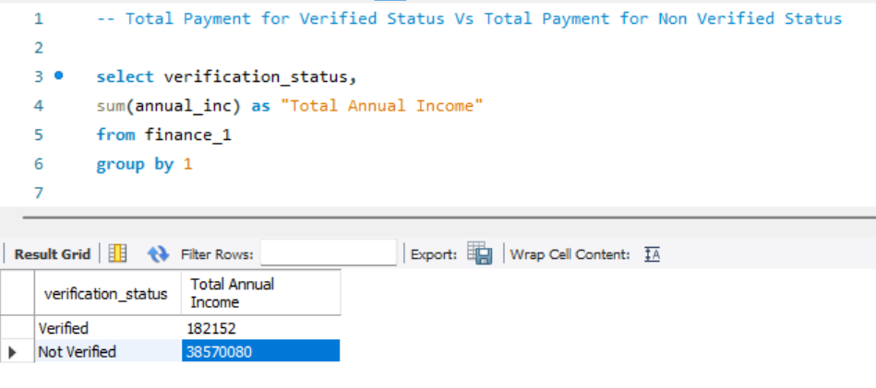
The total annual income for individuals with a verified status exceeded that of those with a non-verified status. Specifically, verified status comprised 68.19% of the overall payment, while non-verified status accounted for 31.81%.

Slide 6
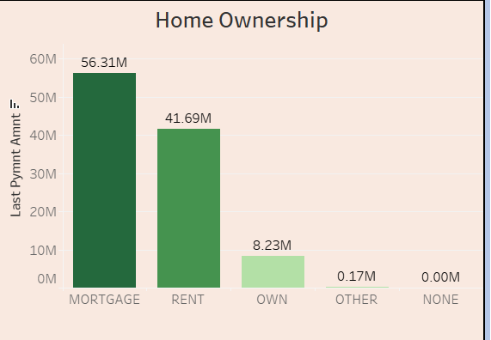
Among the different categories, MORTGAGE takes the lead with a substantial 52.92% share of the total Sum of last payment amount in home ownership, followed closely by the rent and own categories.

Slide 7
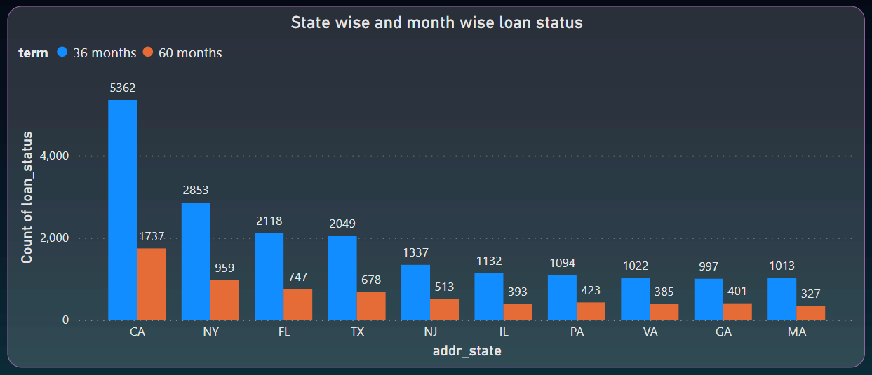
The number of loans with a 36-month term, totaling 18,977, exceeded the count of loans with a 60-month term, which was 6,563.
In the context of a 36-month term, the loans in California (CA) constituted 20.99% of the total count of loan statuses.

Slide 8
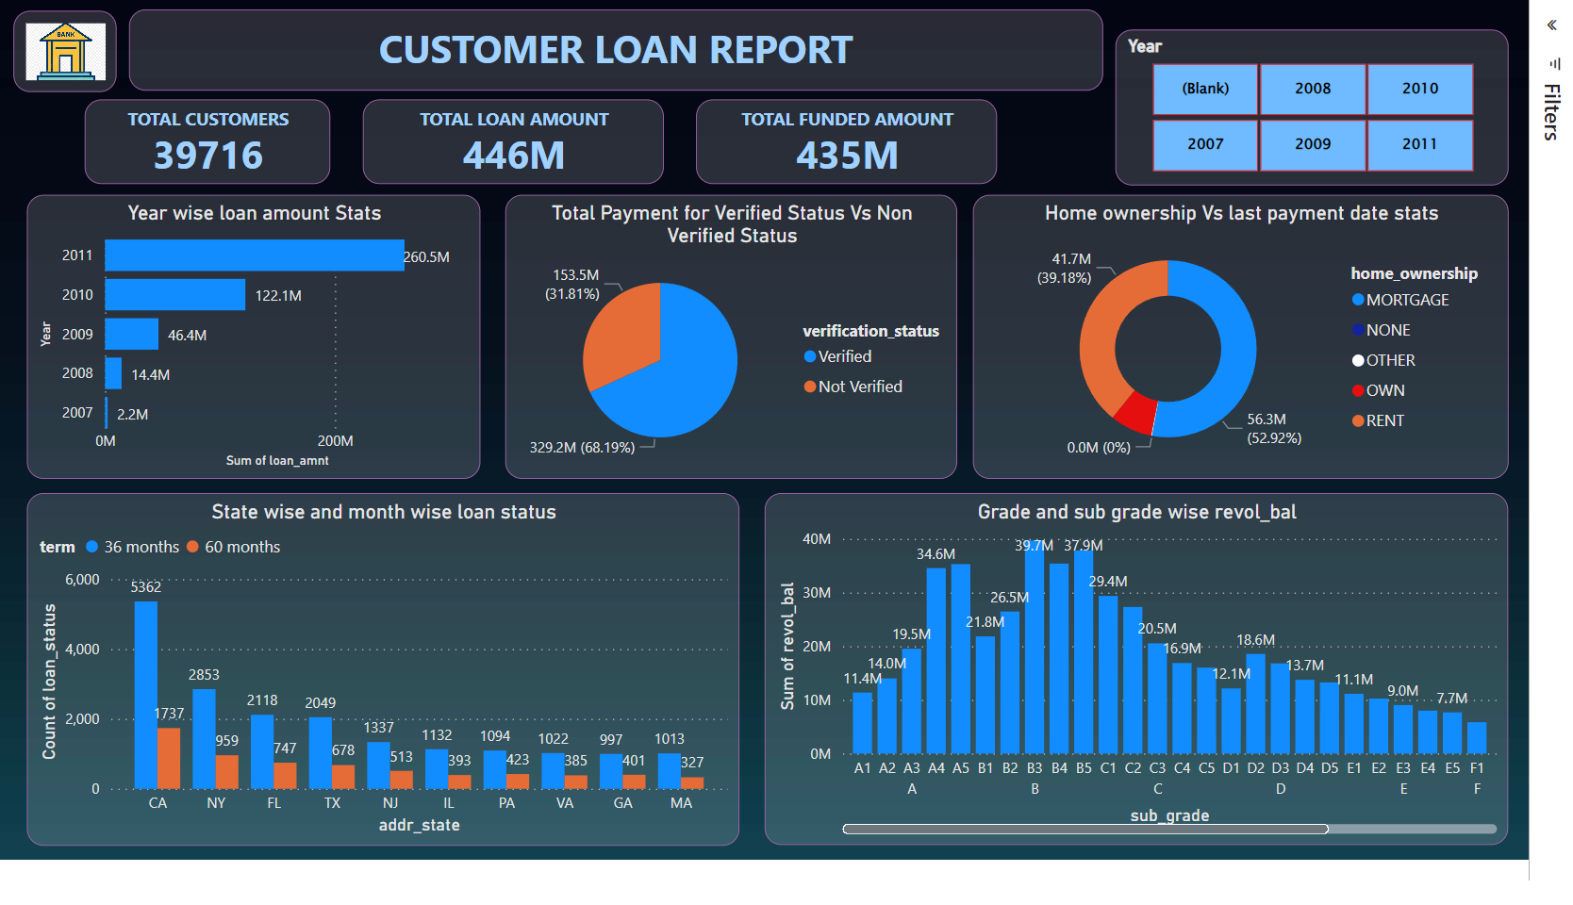

Slide 9
Valuable Insights
In KPI 2 grade B has a much higher sum of revolving balance than grade G, which could mean that they have different levels of financial stability or creditworthiness.
The data clearly indicates a significant increase in the total loan amounts between 2007 and 2011.This information is crucial as it enables us to understand the broader economic scenario and make informed decisions while managing their loan portfolios.
We can understand that individuals with verified status make significantly larger contributions to overall payments compared to those without verification. This highlights the crucial role of verifying applicant information in assessing risk and making informed decisions.
MORTGAGE appears to be the dominant category in terms of the last payment amount. Clients may want to focus on this category for potential investment opportunities or marketing strategies.
Analyzing the distribution of loans by their term duration, such as 36-month or 60-month loans, is vital for assessing risk and allocating resources effectively. A higher number of 36-month loans indicates a prevailing trend in this category. This trend provides valuable insights for our clients to make informed decisions.
These insights can be applied to make better decisions in areas like loan eligibility, marketing tactics, and resource allocation, enhancing their operational effectiveness.

Slide 10
Team Members
Shubhkaram Singh Thind
Chaitanya Rohidas Patil
Rupesh Vilas Ravate
Ranjithkumar.L
Syed Zubair
Ullas. M.B.
Sohit

Slide 11
Thank You

